Slide 1
DS700 Final Project
Fargo Health Care – Forecasting Cardiovascular Examination levels using Time Series: Process and Findings
Notes:
Hello and Welcome ! This presentation covers the results of the discovery process as applied to the needs of Fargo Health Care and their desire to better estimate the number of cardiovascular examinations they will encounter on a monthly basis.

Slide 2
Current State of Affairs
Examinations are not always completed in a timely manner:
Lack of manpower often causes cases to exceed a thirty-day window mandated by the Regional Office of Health Oversight (ROHO)
Lack of manpower often causes cases to be transferred to out-of-network clinics (OCs) which have no ROHO mandate.
This results in:
$200/day/patient fines from the ROHO
On average, a $1250 higher cost for a case to be serviced out of network.
A reduction of resources that could be devoted to hiring more in-house physicians.
A decrease of the level of services that can be provided to the public.
An increase in the amount of administrative costs to track these inefficiencies (outsourced cases and cases past 30 days).
A greater share of cases in the hands of OCs not bound by the 30-day ROHO guidelines.
Notes:
The current state of affairs shows inefficiencies that are costly to Fargo on a number of fronts: Regulatory, Financial, and Customer-Facing. A right-sized staff can minimize outsourcing of patients to OCs and reduce the rate of resulting transfer costs and fines. Fewer dollars will need to be spent on clerical tracking of mandated service times; those resources can be redirected into the hiring of new physicians.

Slide 3
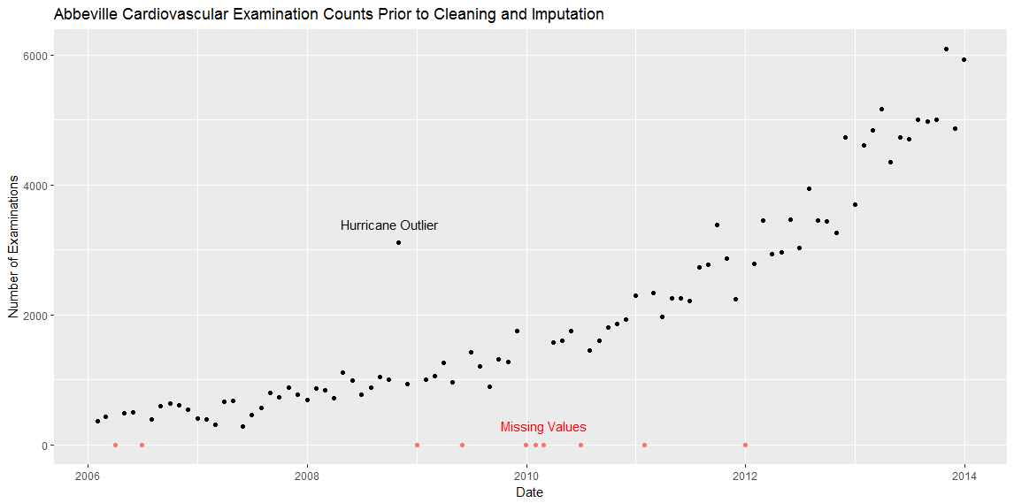
A Different Approach… (1)
Learn from the past to show us the future:
Notes:
To achieve these goals, we can adopt a data-driven approach and learn from the past to better understand the future. Shown here is a plot of data covering the last eight years of cardiovascular exam counts from Fargo’s Abbeville LA location. An unmistakable, ramping trend is evident. Called out as well are the values that were unavailable to the analysis due to either missing or invalid data. Additionally, the data point from October 2008 was not used as-is due to its obvious outlier position. Methods for resolving those will be discussed on future slides.

Slide 4
A Different Approach… (2)
Use data-driven analytics using past records of historical examination levels to forecast upcoming demand.
Time Series models are an appropriate tool for this purpose.
Time Series models are used in many industries as decision-making tools.
These models have the ability to take into account random fluctuations, increasing or decreasing trends, and seasonality spikes.
The models can also give us a range of forecasted examination levels with 80% and 95% confidence.
Other available tools allow us to counteract the effects of missing or bad data (Amelia).
They can ‘impute’ a result in that data point’s place.
We can see the expected ranges of that imputed value as well.
Notes:
Time-series models are used widely by financial, industrial, and governmental entities and there is a wide repository of knowledge available on how best to apply them. Stock markets thrive on, among other things, the ability to make decisions based on them. They apply just as well in a forecast of cardiac examination counts. Tools also exist to assist us with replacing the missing values in a dataset with values that make sense in the context of the other data provided. That process is called imputation, and a package called Amelia was utilized to aid the analysis. But first, a quick primer regarding the components of a time series:

Slide 5
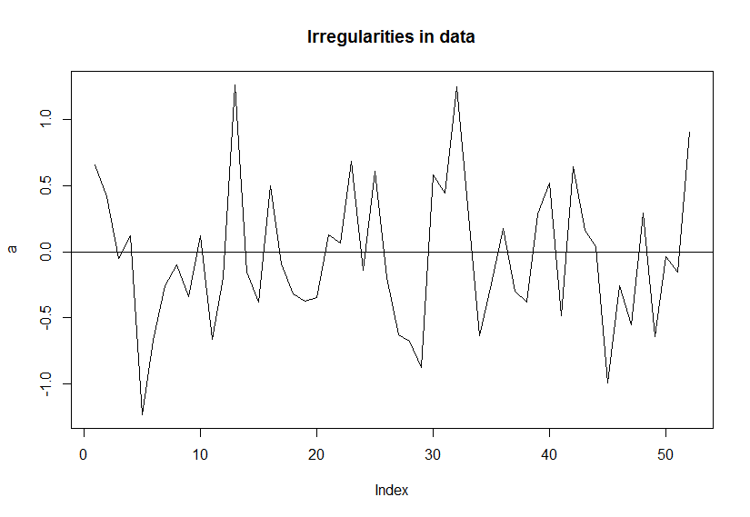
A Primer on Time Series concepts (1)
Stationary time series – shows the ‘noise’ and fluctuations due to irregularities.
Notes:
A time series can be stationary and have ‘noise’ above or below an average. That noise is simply the everyday random fluctuations that can happen in any process.

Slide 6
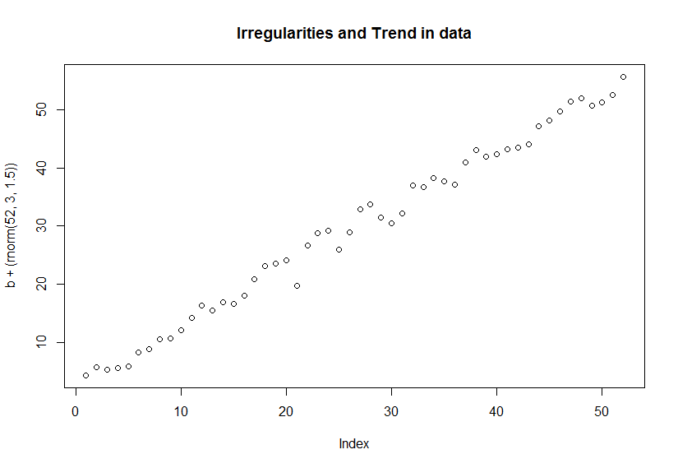
A Primer on Time Series concepts (2)
A time series with both upward trends and irregularities:
Notes:
Of course, you can also have that in conjunction with a rising trend over time. This plot shows an example of an obvious uptick in level plus occasional highs and lows.

Slide 7
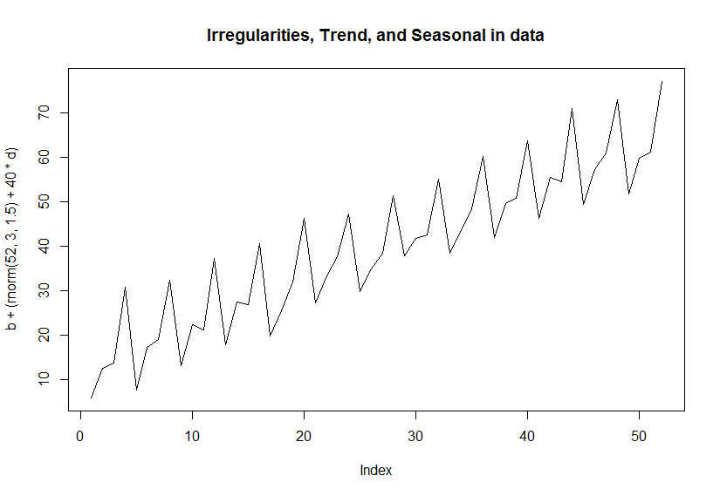
A Primer on Time Series concepts (3)
A time series with upward trends, irregularities:, and seasonality
Notes:
Or, you can have irregularities, uptrend, AND seasonality. That is to say, a regularly-occurring time-dependent pattern in the time series that needs to be modeled into the process. As the analysis will show, there were no prior assumptions made as to how heavily to weight any or all of those characteristics.

Slide 8
Methods Employed – Cleaning Data (1)
Occasionally. data points were unusable in the analysis for a number of reasons:
Some were missing outright
Some were overlaid with non-numeric data or garbage
Other points had highly improbable values (999999999).
Others were outliers that would have affected the analysis:
October 2008 had a one-time spike due to the closure of the New Orleans facility
Some data points had to re-constructed through Excel
December 2013 counts (5933) could be cross-referenced through other records
May 2007 saw the Abbeville facility closed and cases re-routed. Those should count (280 total) toward the forecast.
Ranges of data were unavailable in detail but known in summary
Details for December 2009 through February 2010 were unavailable, but there were 5129 confirmed examinations across that span.
Notes:
Prior to the analysis, the dataset needed to be prepared and cleaned up in order for it to be useful in such an analysis. Six different classifications of error types are listed on the slide, ranging from outright omissions, unusable data, and outlier processing. Data reconstruction had to be undertaken in several instaLances from historical data provided in an Excel spreadsheet. Lastly, and most notably, there were three months near the end of 2009 / beginning of 2010 where we knew the total number of examinations for that month, but not the details. All those were dealt with in the Amelia product and replaced with appropriate estimates.

Slide 9
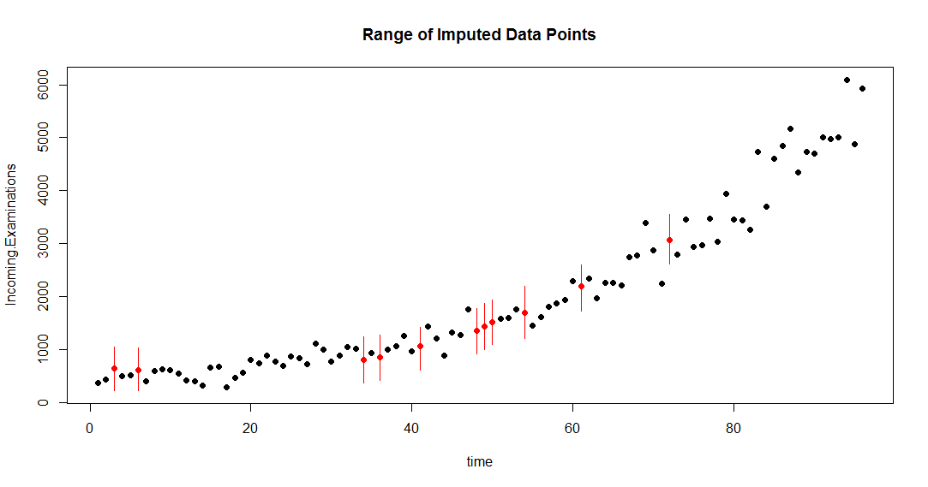
Methods Employed – Cleaning Data (2)
Items that were dropped were re-added through the Amelia package for data imputation.
It uses the context of the other data points in the time series to choose an appropriate replacement.
Simulations ran until one was found with the missing three month span approximately at the levels reported.
Notes:
The resulting dataset with the imputed values called out for notice is shown here. The replaced values are in red, along with a red bar that notes plus or minus two standard deviations’ range that the value could have ostensibly fallen into. Since we knew the values for the three consecutive months in October 2009 – seen near the middle of the chart - simulations were preformed until those three closely matched the known total value. At that point, the simulation concluded and that run was the basis for replacing the other missing points.

Slide 10
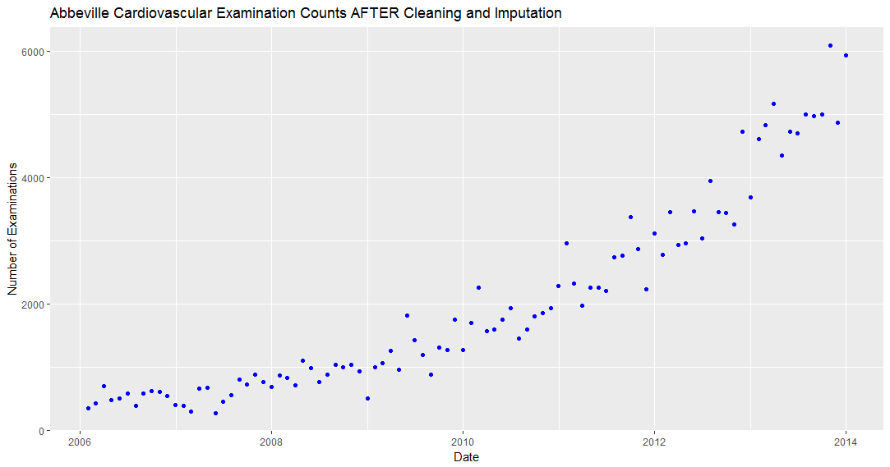
Methods Employed – Cleaning Data (3)
Replacing the missing values with the imputed ones derived in Amelia leaves us with the following dataset to forecast against.:
Notes:
With those replacements added to the dataset, the data is now to the point to where a time series can be derived from it.

Slide 11
Methods Employed – Modeling the Forecast(1)
ARIMA and Exponential Time Series (ETS) models are utilized in this evaluation.
Both can model data with irregularities, trend and seasonality, or combinations thereof.
Both cam be evaluated on scoring criteria and goodness of fit of their characteristics.
Both can choose the appropriate best settings to minimize errors.
Notes:
The two time series models being considered for this application are ARIMA and an exponential time series, abbreviated here as ETS. They both have different approaches to solving the problem, but on the other hand they do have common values and characteristics that we can use to score which of the two performed better and is the appropriate one to use in this situation.

Slide 12
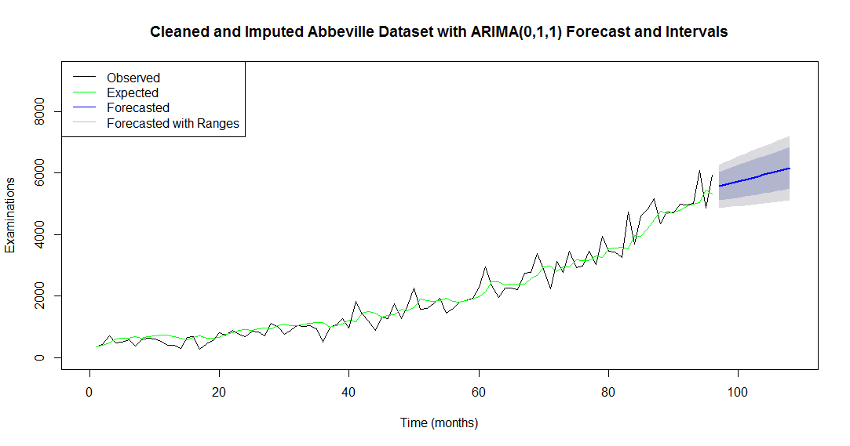
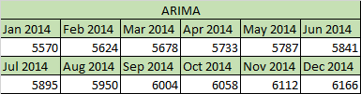
Methods Employed – Modeling the Forecast(2)
First, the results from ARIMA. The shaded area shows the 80% and 95% confidence intervals:
Notes:
The output from the ARIMA process shows a line in green illustrating the model’s expected value for that time period, overlaid on the black line which is our roster of actual and imputed values provided. At the right end of the chart, the solid blue line is a representation of the forecasted values listed in the spreadsheet excerpt at the bottom of the slide. The forecast also provides insight on an expected range of values. The 80% confidence window is the darker-shaded plot, and the 95% window is the lighter-shaded plot.

Slide 13
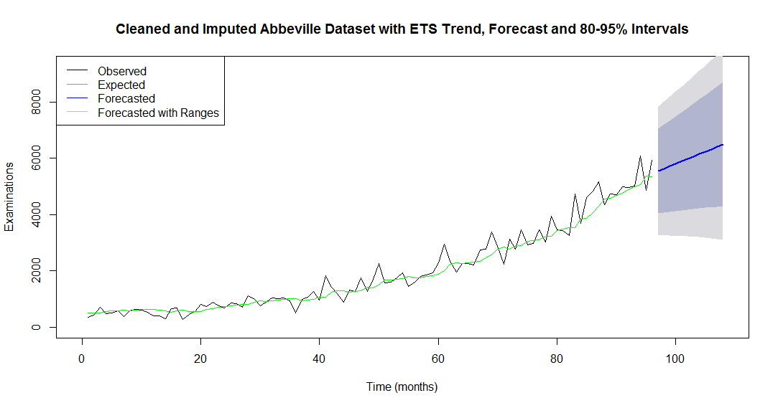
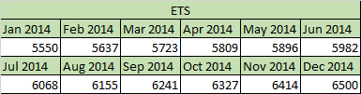
Methods Employed – Modeling the Forecast(3)
Next, the results from an exponential time series (ETS):
Notes:
The same process is applied using the ETS model. The resulting forecasts from it are provided as well. The line in green is the model’s expected value for that time period, and the black line is again our actuals. Note that the 80 and 95% confidence intervals are significantly wider in this analysis, which means that our range of values could fall over a wider spectrum and provide less certainty about upcoming staffing levels. That will need to be taken into account when choosing our model along with the scoring measures noted on the next several slides.

Slide 14

Methods Employed – Scoring the Forecast(1)
Which method is better? There are a few standard measures:
Mean Absolute Deviation (MAD), which is the average absolute difference between estimated and actual data. Across all data points considered,
Mean Absolute Percentage Error (MAPE), which is the average percentage difference between estimated and actual data.
Mean Squared Error (MSE), which is the squared value of the difference between estimated and actual data. Root Mean Square Error (RMSE) is simply the square root of MSE.
The Akaike Information Criterion (AIC) is a common scoring process for model comparison. Its utility, to quote its Wikipedia page, is to “deal with the trade-off between the goodness of fit of the model and the complexity of the model”. A lower score indicates a better combination of fit and complexity.
Notes:
Given the scoring measures noted on the slide, the ARIMA model looks to score closer in three of the four (Root Mean Square error is just the square root of MSE so it is counted along with it and not distinctly). These are essentially scoring characteristics of the green line fitted to the plot on the last slides. Also, as noted prior, ARIMA has a narrower band of certainty around the forecast, making it more attractive for decision-making. There are additional tests to consider, however.

Slide 15
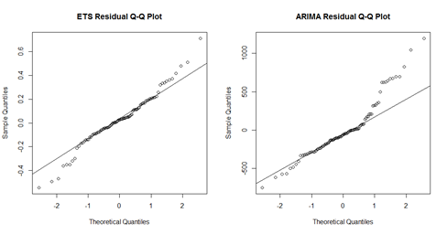
Methods Employed – Scoring the Forecast(2)
Looks pretty evenly scored, but with ARIMA in the lead. Anything else cautionary?
Models are better when their errors from actual (called residuals) tend to zero on average.
ARIMA doesn’t do as well a job in that regard with this dataset for recent data. ETS wins out here, at least visually.
However, both models passed the Box-Ljung test, which checks for dependencies within residuals.
Notes:
The last evaluation centers around the residuals, which are the each of the errors between actual and forecast. Remembering back to the earlier slides, it’s the difference between the green and black lines at each point in the process. ARIMA looks not to do as well here. The Q-Q plot notes how far those residuals are off from how far they ‘should’ be off. Residuals should be roughly situated with as many points above as below zero, and not with their values increasing as ARIMA does here. In future analyses, it may need to be log-transformed to make it easier to forecast with. The visuals aside, there is a process called the Box-Ljung test that can determine whether the fit is too far off for us to consider it a valid model. Both models passed, so *at this point* the residuals are not a concern, but future evaluations may not find that to be the case.

Slide 16
Summarization of Key Findings
The issues with quality of forecast data were successfully reconciled by the use of the Amelia imputation package.
An ARIMA (Auto-Regressive Integrated Moving Average) forecast can be applied to provide a mean percentage error of roughly 18% in the number of cardiovascular cases from month-to-month.
The same time series can also provide 80% and 95% confidence values for future forecasts so that worst-case ranges are known.
Notes:
As a result, the ARIMA model was chosen to move forward with. To summarize the findings of the discovery process, it can forecast within a roughly 18% window for expected cardiovascular caseload. Decision-makers also have the benefit of confidence ranges and have freedom to use those for worst-case scenario in hiring practices, as well as worst-case scenarios for financial effects due to the outsourcing of additional cases to OCs. Lastly, missing or invalid values need not be a limitation in adopting this model. It has been shown that those sort of issues can be compensated for.

Slide 17
Recommendations (1)
Institution of a pilot program to implement actions based on the results of these findings in the cardiovascular unit:
Evaluate the need for changes in hiring rates for cardiovascular physicians given the rate of growth, assuming that the desire to keep the number of cases serviced per physician remains the same.
HR to develop a plan for physician hiring rates to satisfy the targets presented in the 12-month forecast.
Institution of a committee to meet – at maximum – on a quarterly basis with consideration of the following agenda as the pilot expands:
Evaluation of the continued effectivity of the model with the goal of determining how to improve its accuracy. For example: What steps need to be taken to improve data entry quality so that less data imputation will be necessary.
Establishment of timeframes to expand the process to include other direct-care services that the hospital provides.
Establishment of timeframes to expand the process to other Fargo locations and a reporting of the basis on which those decisions are made.
Evaluation of whether the model reduces the number of fines paid out as a result of increased service times. Is the overall days-to-service decreasing? A reported projection on yearly cost savings to Fargo should be the deliverable.
Notes:
A handful of recommendations are noted to conclude this analysis:
An evaluation can be made to determine whether level-of-care services are sufficient for the near term until the forecasted increases take effect.
At some point, HR has now the information to develop a plan in tandem with expected caseloads.
Should this be adopted, it needs oversight, improvement, and the creation of metrics to determine if the desired value is being gained from it. An ongoing committee should have purview for the following:
Improvement of the model.
Timing for expansion of the model to other Abbeville services
Timing for expansion of the model to other Fargo locations
A financial basis : Are there reductions in thirty-day fines and OC charges?

Slide 18
Recommendations (2)
Institution of a committee to meet – at maximum – on a quarterly basis with consideration of the following agenda as the pilot expands:
Evaluation of whether the model - when executed – influences service times/patient as well as patient sentiment.
Establishment of a process to make the findings available to other institutions and affected parties once out of the pilot stage.
Establishment of a process to ensure that no bias is introduced by the actions of the committee. Access to services should remain equitable for all.
Notes:
There should also be an evaluation of whether customer-facing attributes have been improved, such as turnaround times for service. Should this be found to improve matters here, the findings should be published, at least in summary, so that other institutions might improve the quality of service for their patients as well. And lastly, a circumspect view as to the expansion and availability of these more-efficient services to the public. The subsequent types of service to next apply the model to and decisions on which locations should be rolled out to next should ensure that all segments of society are served without bias towards any.
That concludes today’s presentation.

